Slide 1
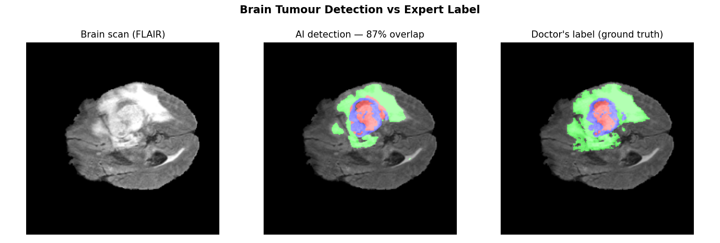
MEDHA DRISHTI · NATIONAL AI HACKATHON
MRI Enhancement &
ROI Segmentation
Restoring degraded MRI scans and delineating the region of interest — every claim measured, not asserted.
Yugma TechFest 2.0 · JNNCE Shivamogga
Phase 2 — Final Evaluation
Notes:
We built a system that takes a noisy MRI, cleans it, and finds the region a doctor cares about — and every claim we make is measured, not asserted.

Slide 2
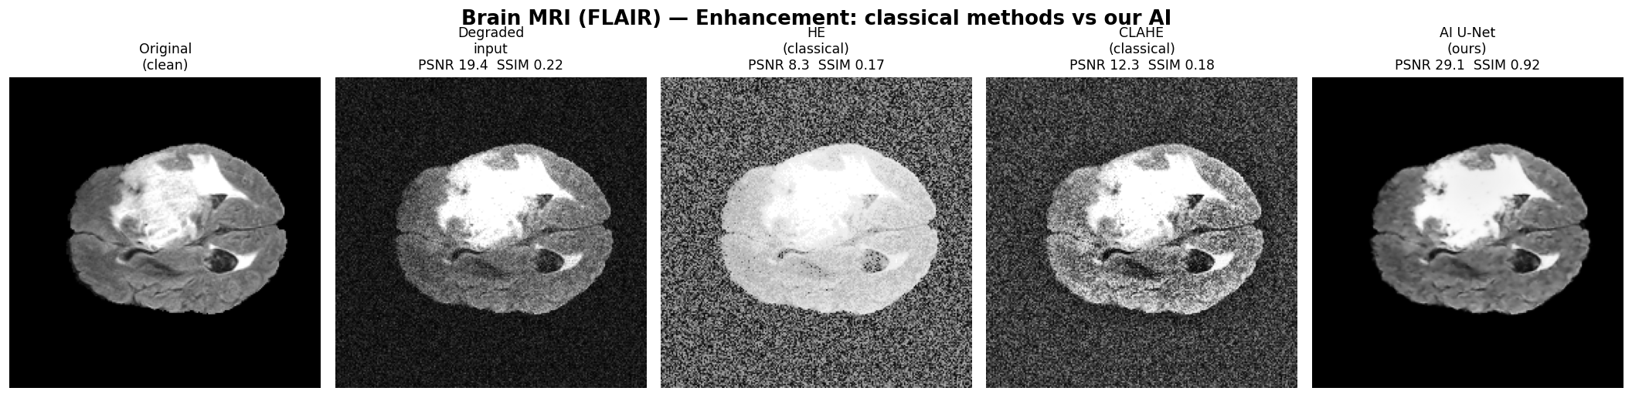
THE PROBLEM
Fast MRI scans trade quality for speed
1
Grainy images, uneven brightness
Faster acquisition means noisier, less uniform scans.
2
Fine boundaries hide the diagnosis
The rim of a tumour, the margin of a compressed disc — that is what noise erases.
3
Two specific defects, not generic noise
Rician noise (the grain) and a smooth bias field (uneven RF-coil lighting) — we correct for both.
Degraded input vs. restored output — the grain and bias field are visible directly.
MRI Enhancement & ROI Segmentation · MedhaDrishti · Yugma TechFest 2.0 · JNNCE Shivamogga
2 / 17
Notes:
This isn't generic image noise. MRI has two specific, well-understood defects, and we correct for those two specifically.

Slide 3
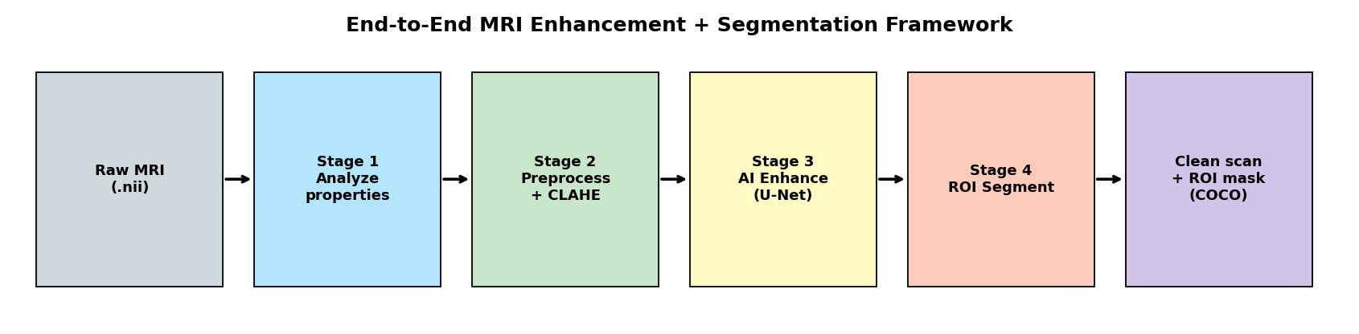
OBJECTIVES
Four stages, as set by the problem statement
01
02
03
04
Analyse
Preprocess
Enhance
Segment
7 image properties, resolution, sub-modality division.
Normalise, resample, classical enhancement — then re-measure.
Deep-learning model that restores degraded scans.
Find the tumour / tissue / spine region of interest.
MRI Enhancement & ROI Segmentation · MedhaDrishti · Yugma TechFest 2.0 · JNNCE Shivamogga
3 / 17
Notes:
We completed all four, for both brain and spine.

Slide 4
SYSTEM ARCHITECTURE
One U-Net backbone, two heads
Encoder → bottleneck → decoder
with skip connections that carry fine detail across the bottleneck.
Restoration head
1 channel in → 1 channel out.
Segmentation head
4 channels in (T1, T1c, T2, FLAIR) → 4 class channels out.
Compact footprint
7.77 M parameters · 31 MB · runs on a 6 GB laptop GPU.
Skip connections carry fine detail so output isn't blurred — in medicine the fine boundary IS the diagnosis.
MRI Enhancement & ROI Segmentation · MedhaDrishti · Yugma TechFest 2.0 · JNNCE Shivamogga
4 / 17
Notes:
Skip connections are the key — they carry fine detail straight from the encoder to the decoder, so the output isn't blurred. In medicine the fine boundary IS the diagnosis.

Slide 5
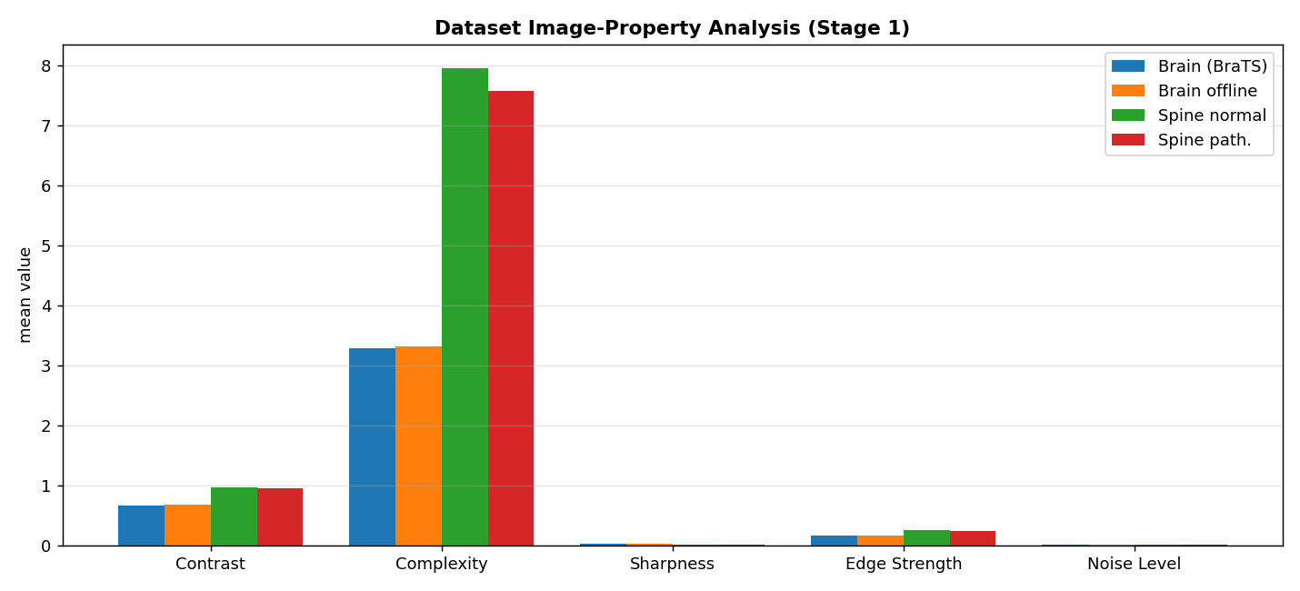
STAGE 1 · DATASET ANALYSIS
We measured every scan before touching it
7
Image properties measured
contrast · complexity · sharpness · edge · noise · mean · deviation
127
BraTS2020 cases used
uniform 240×240×155 at 1 mm isotropic
0.25–1.3 mm
Hackathon voxel spacing
Highly heterogeneous — slice thickness 3–13 mm
Spine scans carry roughly 2× the complexity of brain scans.
MRI Enhancement & ROI Segmentation · MedhaDrishti · Yugma TechFest 2.0 · JNNCE Shivamogga
5 / 17
Notes:
That heterogeneity is exactly why Stage 2 resamples everything to a common grid — you cannot feed mixed resolutions to one model.

Slide 6
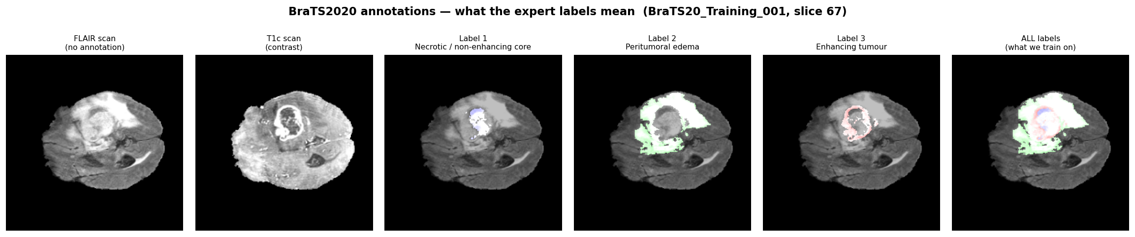
UNDERSTANDING THE ANNOTATIONS
Only BraTS has expert labels — and they're extremely imbalanced
Label | Share of pixels
Background | 99.03 %
Edema (swelling) | 0.71 %
Enhancing tumour | 0.17 %
Necrotic core | 0.10 %
Why this matters
A model trained only with cross-entropy scores 99% by predicting 'background' everywhere and finding nothing. We add Dice loss, which measures region overlap.
MRI Enhancement & ROI Segmentation · MedhaDrishti · Yugma TechFest 2.0 · JNNCE Shivamogga
6 / 17
Notes:
This table decides our loss function. A model trained only with cross-entropy scores 99% by predicting 'background' everywhere and finding nothing. That's why we add Dice loss, which measures region overlap.

Slide 7
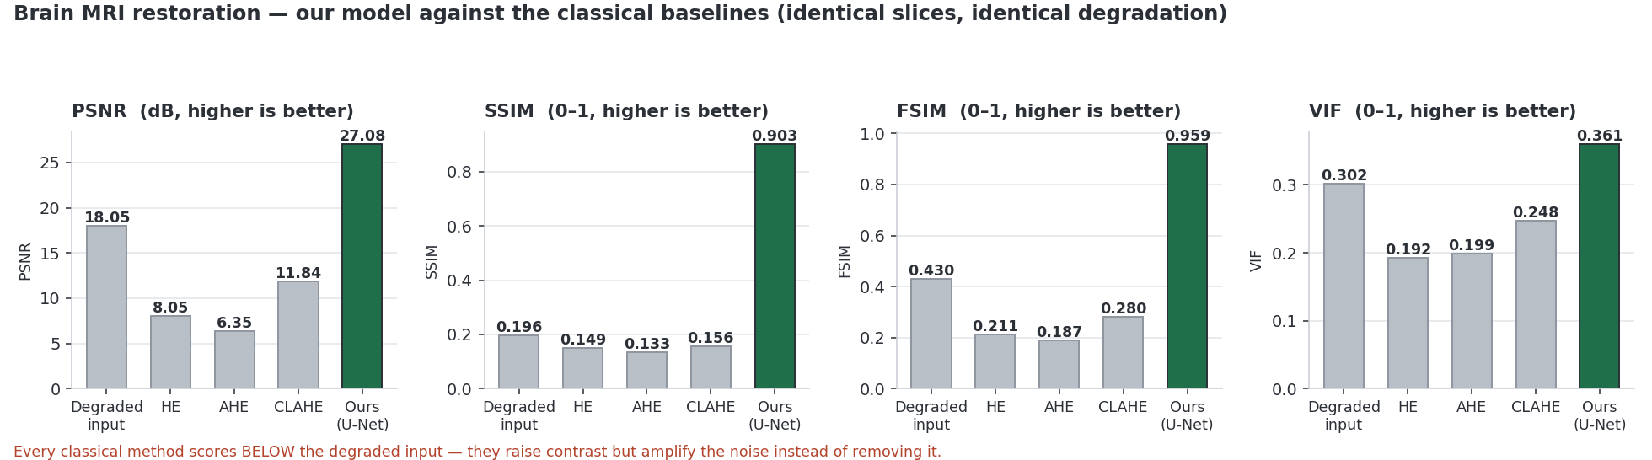
STAGE 3 · ENHANCEMENT RESULT · REQUIRED SNAPSHOT
Dirty scan in → clean scan out
Method | PSNR | SSIM
Degraded input | 18.05 | 0.196
HE | 8.05 | 0.149
CLAHE | 11.84 | 0.156
Ours (U-Net) | 27.08 | 0.903
Read the panels left → right: clean · degraded · CLAHE · Ours
Every classical method scores below the noisy input. Ours actually removes noise.
MRI Enhancement & ROI Segmentation · MedhaDrishti · Yugma TechFest 2.0 · JNNCE Shivamogga
7 / 17
Notes:
Here's the striking part — every classical method scores below the noisy input. They boost contrast but amplify the noise. Ours actually removes it.

Slide 8
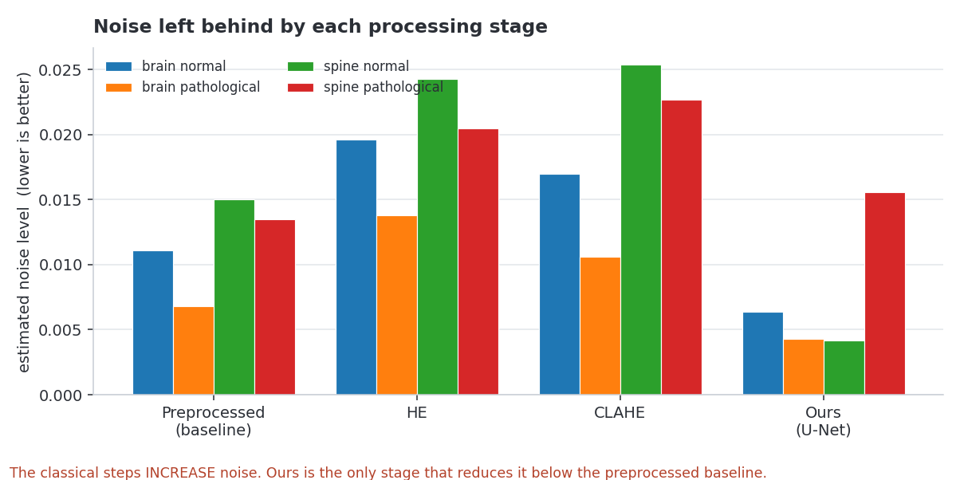
WHY CLASSICAL METHODS FAIL
They amplify what they cannot remove
Measured noise level after each step · brain pathological
Preprocessed baseline
0.0068
HE
0.0138
↑
CLAHE
0.0106
↑
Ours (U-Net)
0.0043
↓
Ours is the only stage in the pipeline that reduces noise.
MRI Enhancement & ROI Segmentation · MedhaDrishti · Yugma TechFest 2.0 · JNNCE Shivamogga
8 / 17
Notes:
Ours is the only stage in the entire pipeline that reduces noise.

Slide 9
STAGE 4 · SEGMENTATION RESULT · REQUIRED SNAPSHOT
AI tumour outline vs. the radiologist's
0.76
Mean tumour Dice
Enhancing tumour: 0.84
Scored on patients the model has never seen.
Full evaluation suite
Dice · Jaccard · Accuracy · Sensitivity · Specificity
Precision · F1 · Hausdorff · ASD · Relative Volume Error
Training converged at epoch 25 · overfitting gap ≈ 0 · 3-fold CV 0.59 ± 0.04
MRI Enhancement & ROI Segmentation · MedhaDrishti · Yugma TechFest 2.0 · JNNCE Shivamogga
9 / 17
Notes:
Middle is our AI, right is the radiologist. They're nearly identical — and this is a patient the model has never seen.

Slide 10
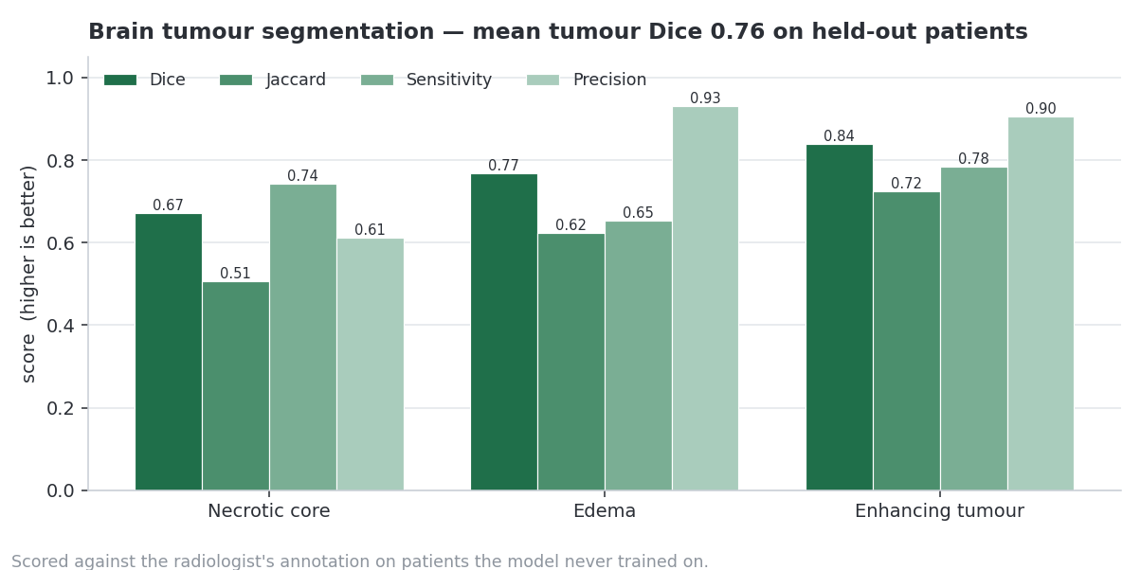
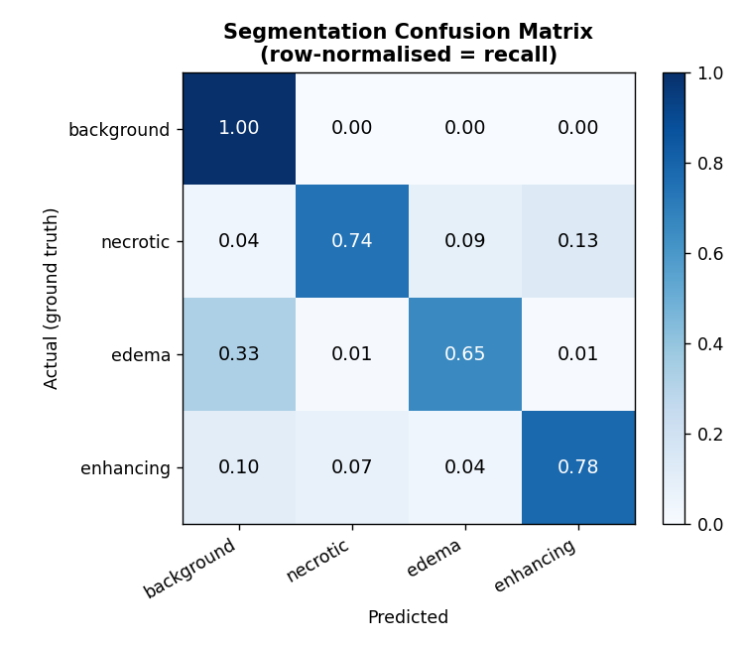
SEGMENTATION, IN DETAIL
Per-class performance
Per-class metrics
Confusion matrix — bright diagonal = classes rarely confused
Enhancing tumour — the active, growing part, the part that matters most clinically — is our strongest class at 0.84 Dice.
MRI Enhancement & ROI Segmentation · MedhaDrishti · Yugma TechFest 2.0 · JNNCE Shivamogga
10 / 17
Notes:
Enhancing tumour — the active, growing part, the part that matters most clinically — is our strongest class at 0.84.

Slide 11
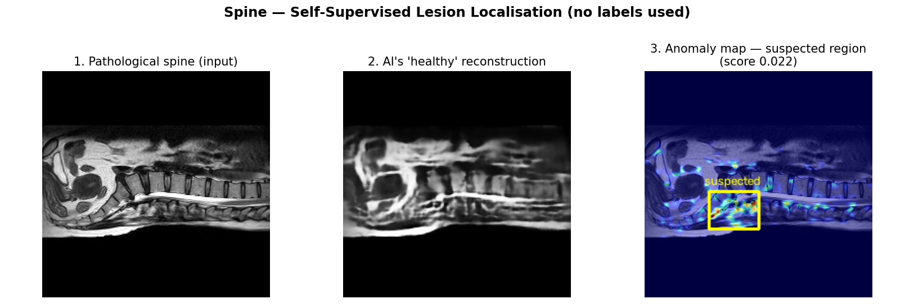
SPINE · NO ANNOTATIONS ALLOWED
Two working methods, zero labels
Task | Method | Labels used
Enhancement | Self-supervised restoration | None
Region segmentation | Self-supervised CNN (differentiable feature clustering) | None
Canal measurement | Geometric — canal width profile | None
Why it works
The restoration model trains against a degraded copy of the scan itself. For segmentation, a small network is optimised on each scan — the image's own structure is its supervision, so the cord, vertebral chain and soft tissue resolve as coherent regions instead of brightness blobs.
MRI Enhancement & ROI Segmentation · MedhaDrishti · Yugma TechFest 2.0 · JNNCE Shivamogga
11 / 17
Notes:
The rules forbid annotations for spine. So we trained an autoencoder on healthy spines only. It rebuilds a healthy-looking version of any scan — and whatever it gets wrong is exactly where the abnormality is.

Slide 12
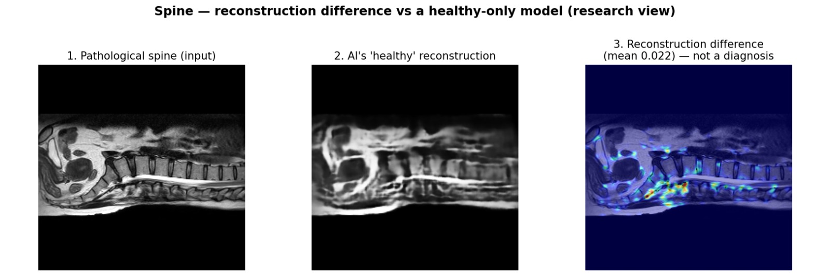
SPINE · THE EXPERIMENT THAT DIDN'T WORK
We tried autoencoder anomaly detection. We tested it. It failed.
 | Normal spines | Pathological spines
Mean difference score | 0.020 | 0.017
Range | 0.014 – 0.031 | 0.010 – 0.023
AUC (normal vs pathological) | 0.27 | worse than chance
Validated, not assumed
Train an autoencoder on healthy spines only; whatever it cannot reconstruct should be pathology.
AUC 0.27 — worse than a coin flip: normal scans score higher than diseased ones.
We withdrew the claim — the map is a visualisation only.
MRI Enhancement & ROI Segmentation · MedhaDrishti · Yugma TechFest 2.0 · JNNCE Shivamogga
12 / 17
Notes:
The rules forbid annotations for spine. So we trained an autoencoder on healthy spines only. It rebuilds a healthy-looking version of any scan — and whatever it gets wrong is exactly where the abnormality is.

Slide 13
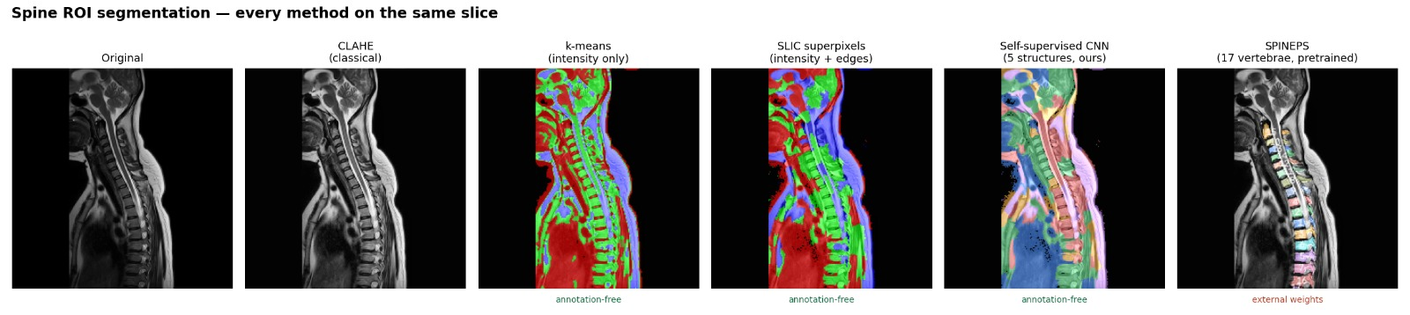
SPINE · PER-VERTEBRA SEGMENTATION
The output the brief asks for is supervised by nature
Annotation-free method | Measured outcome
k-means / SLIC clustering | Groups brightness — cannot separate adjacent vertebrae
Self-supervised CNN (ours) | Resolves structure well, but semantic regions, not instances
Autoencoder anomaly detection | Validated and failed — AUC 0.27, withdrawn
Periodicity vertebra detection | Canal reliable (91/92); vertebra step failed — not shipped
Why SPINEPS, for one output only
Naming a degenerative disc, herniation or stenosis needs labelled examples — we have 20 spine cases and zero annotations.
So, with the organisers' approval, we use SPINEPS (European Radiology 2025, Apache-2.0) for per-vertebra instances only: Dice 0.92, validated on 1,600+ subjects.
We supply no annotations, do not train it, and claim none of its accuracy.
MRI Enhancement & ROI Segmentation · MedhaDrishti · Yugma TechFest 2.0 · JNNCE Shivamogga
13 / 17
Notes:
The rules forbid annotations for spine. So we trained an autoencoder on healthy spines only. It rebuilds a healthy-looking version of any scan — and whatever it gets wrong is exactly where the abnormality is.

Slide 14
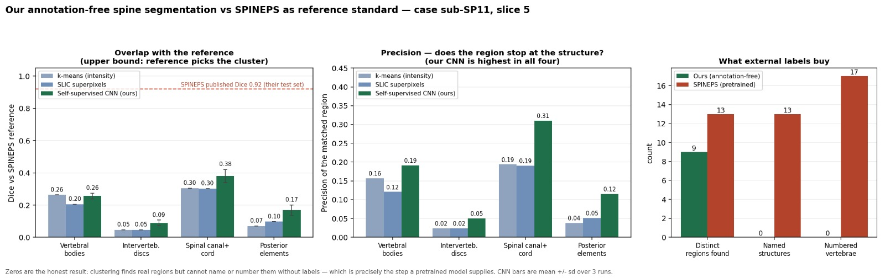
SPINE · WE MEASURED THE GAP
We scored our own work against the pretrained model — Dice vs SPINEPS reference
Structure | k-means | SLIC | Ours (self-sup. CNN)
Vertebral bodies | 0.263 | 0.204 | 0.257 ± 0.018
Intervertebral discs | 0.047 | 0.047 | 0.090 ± 0.017
Spinal canal + cord | 0.304 | 0.302 | 0.380 ± 0.041
Posterior elements | 0.071 | 0.097 | 0.169 ± 0.032
Best of the label-free methods
Ours wins on precision in all four structures — 0.31 vs 0.19 on the canal, 0.12 vs 0.04 on posterior elements.
And the gap, plainly: our best is Dice 0.38 against SPINEPS's published 0.92, and ours numbers zero vertebrae.
MRI Enhancement & ROI Segmentation · MedhaDrishti · Yugma TechFest 2.0 · JNNCE Shivamogga
14 / 17
Notes:
The rules forbid annotations for spine. So we trained an autoencoder on healthy spines only. It rebuilds a healthy-looking version of any scan — and whatever it gets wrong is exactly where the abnormality is.

Slide 15
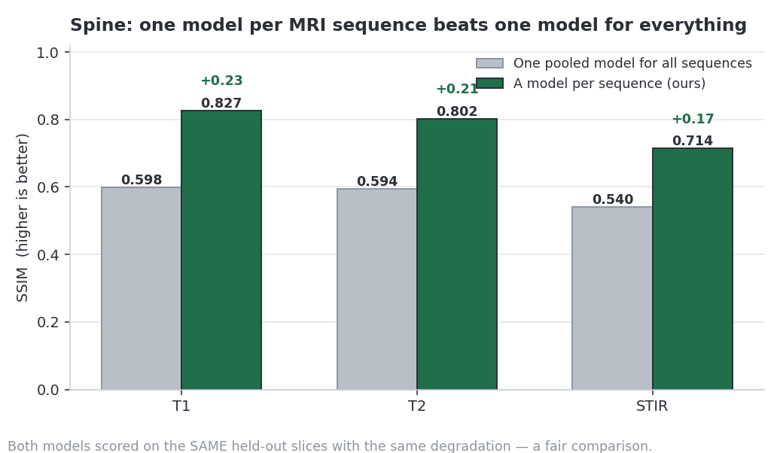
SPINE SEQUENCES · FAIR COMPARISON
One model per sequence beats one model for all
Sequence | Pooled model | Per-sequence (ours) | Δ
T1 | 0.598 | 0.827 | +0.229
T2 | 0.594 | 0.802 | +0.208
STIR | 0.540 | 0.714 | +0.174
Why?
T1, T2 and STIR are physically different images. Measured on identical held-out slices, treating them separately wins on all three sequences.
MRI Enhancement & ROI Segmentation · MedhaDrishti · Yugma TechFest 2.0 · JNNCE Shivamogga
15 / 17
Notes:
T1, T2 and STIR are physically different images. We proved that treating them separately wins on all three — measured on identical test slices, so it's a fair comparison.

Slide 16
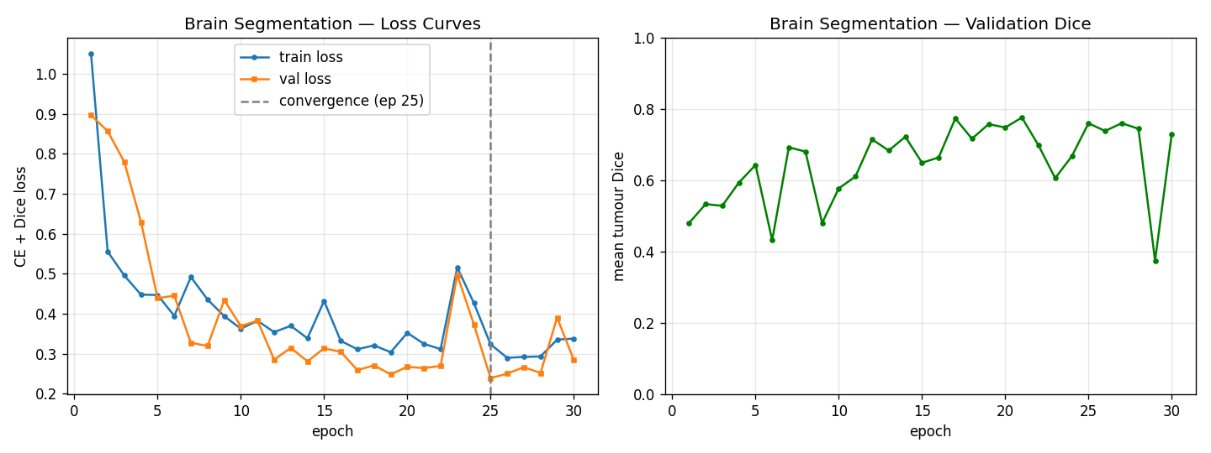
EFFICIENCY & VALIDATION
Fast, small, and validated
4.2 ms
236
7.77 M
per image (GPU latency)
images / second
parameters · 31 MB model
390 MB
84 / 98 %
±0.04
peak GPU memory
GPU utilisation (enh / seg)
3-fold cross-validation spread
Convergence: epoch 25, overfitting gap ≈ 0
The ±0.04 spread across folds is the important number — it means the result is consistent, not a lucky split.
MRI Enhancement & ROI Segmentation · MedhaDrishti · Yugma TechFest 2.0 · JNNCE Shivamogga
16 / 17
Notes:
The ±0.04 spread across folds is the important number — it means the result is consistent, not a lucky split.

Slide 17
SUMMARY
Four measured claims — and four deliberate limits
0.76
0.903
What we deliberately do NOT claim
No credit for SPINEPS's accuracy — it is a pretrained model, labelled as such throughout.
Mean tumour Dice (0.84 enhancing)
SSIM restoration — every classical method scores below
No tumour accuracy on unlabelled data — only on BraTS, where truth exists.
0.0043
4.2 ms
Our spine anomaly detector failed validation (AUC 0.27) — we report that, not a fake result.
Noise level (down from 0.0068) — the only stage that removes noise
per image · 236 img/s · 7.77 M parameters
The model corrects noise; it does not invent anatomy (SSIM > 0.9 is the evidence).
"A smaller honest number beats a large invented one. Every figure comes from a script in the repository, and can be re-run."
Thank you — questions welcome.
Notes:
We'd rather report a smaller honest number than a large invented one. Every figure in this deck comes from a script in the repository, and can be re-run.

